Slide 1
Welcome to the calming room
Hickey Elementary

Slide 2
How it started….

Slide 3
How it’s going…

Slide 4
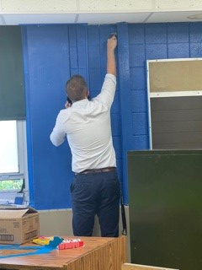
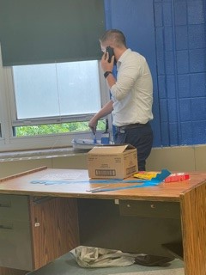
Dr. baird is that you?!?

Slide 5
All hands on deck!

Slide 6
Thank you President & CEO, Bridget Jones and & slps foundation

Slide 7
A few finishing touches…

Slide 8
Very nice!!!! -dr. baird

Slide 9
And now….the moment we have all been waiting for….

